Slide 1
ONLINE SHOPPING SYSTEM FOR FASHION WEAR
Guided by
Dr. Jayasakthi Velmurugan K
CSA4387-Internet Programming for Web Applications .
Saveetha School Of Engineering, Chennai.
A Presented by
A.SIRISHA - 192211584,
K.PRATHIMA - 192211032,
B. SWATHI192210084

Slide 2


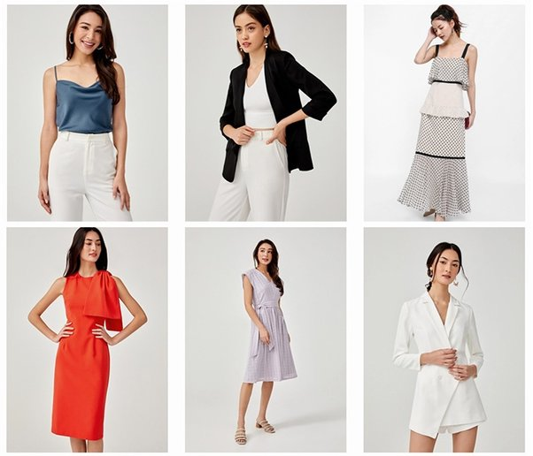
Introduction to Online Fashion Wear Shopping
Online fashion wear shopping has revolutionized the way we explore and purchase clothing.
With just a few clicks, customers can browse a vast array of styles, sizes, and brands from the comfort of their homes.
This convenient shopping method offers detailed product descriptions, customer reviews, and high-quality images to help shoppers make informed decisions.

Slide 3

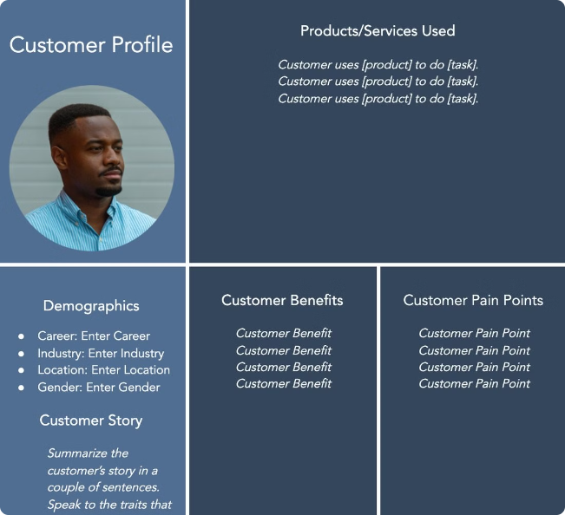
User Registration and Account Management
1
Create an Account
2
Manage Your Profile
Sign up easily with your email address, providing basic personal information.
Update your shipping address, payment information, and track your orders in one convenient location.
3
Personalized Recommendations
Order History
4
The system learns your preferences over time, offering curated product suggestions tailored to your unique taste.
Review past purchases, reorder items, and access purchase receipts for easy reference.

Slide 4
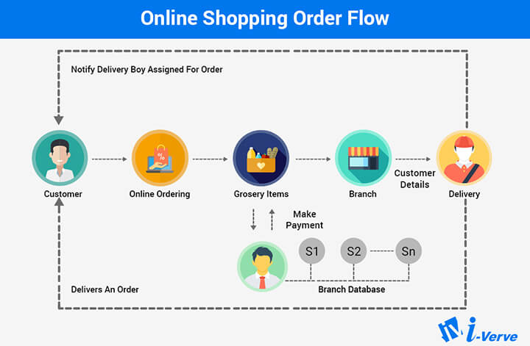

Slide 5
Shopping Cart and Checkout Process
Add to Cart
1
Browse the catalog and select items you wish to purchase, adding them to your virtual shopping cart.
2
Review Cart Contents
Check the items in your cart, adjust quantities, and apply any available discount codes.
Proceed to Checkout
3
Enter your shipping address and select your preferred payment method.
4
Confirm Order
Review your order details, including shipping and billing information, and click "Confirm Order."
Order Confirmation
5
You'll receive a confirmation email with your order details, including a tracking number.

Slide 6

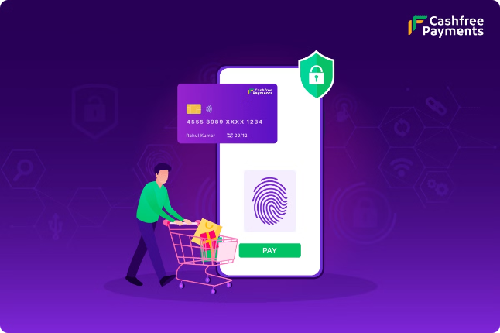
Secure Payment Integration
Secure Payment Gateway
Encryption Technology
All financial information is encrypted during transmission, preventing unauthorized access and ensuring data security.
Payments are processed through trusted and secure payment gateways like PayPal, Stripe, or other popular options.
PCI Compliance
The payment system adheres to industry standards and regulations for secure payment processing.

Slide 7






Delivery and Shipping Options
Shipping Methods
Choose from various shipping options based on your delivery speed and budget, including standard, express, and overnight delivery.
Real-time Tracking
Keep track of your order's journey with real-time updates on its location and estimated delivery time.
Shipping Cost Estimation
Calculate shipping costs before checkout,
so you can budget accordingly.
Delivery Notifications
Receive notifications when your order is shipped, is out for delivery, and has been successfully delivered.

Slide 8


Customer Reviews and Ratings
Product Reviews
Customers can share their experiences with specific products, providing valuable insights for potential buyers.
Rating System
Products are rated on a scale, often from 1 to 5 stars, allowing buyers to quickly assess the quality and value of items.
Feedback & Comments
Users can leave detailed comments, including pros, cons, and suggestions, helping others make informed decisions.

Slide 9






Benefits of Online Fashion Shopping
Convenience
Wide Selection
Shop from the comfort of your home, at any time, without leaving your couch.
Browse a vast array of styles, brands, and sizes, all in one place.
Competitive Prices
Easy Comparisons
Find great deals and discounts on fashion items, often lower than traditional stores.
Compare prices, reviews, and features of different products side-by-side.

Slide 10
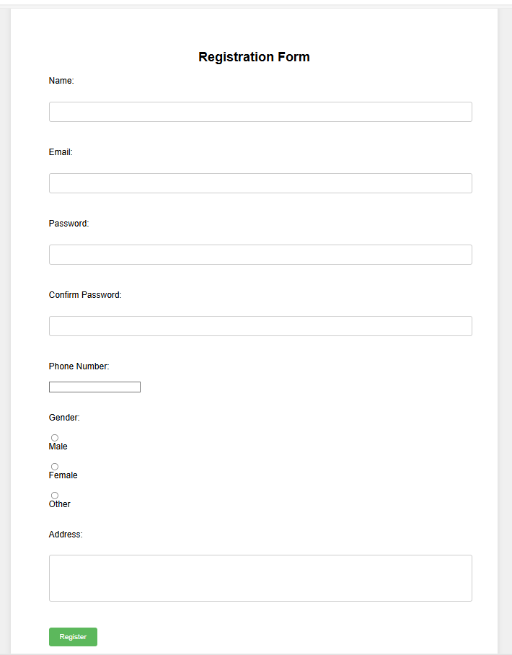
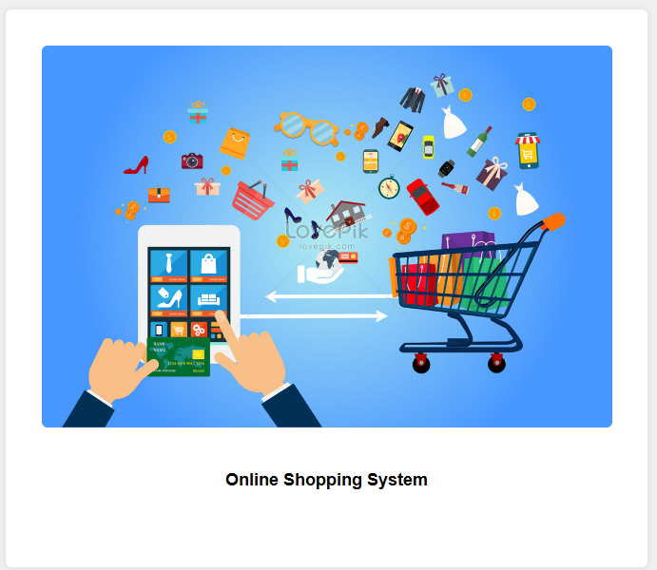
Result:

Slide 11
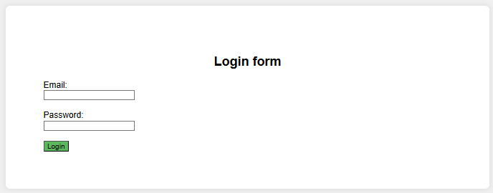
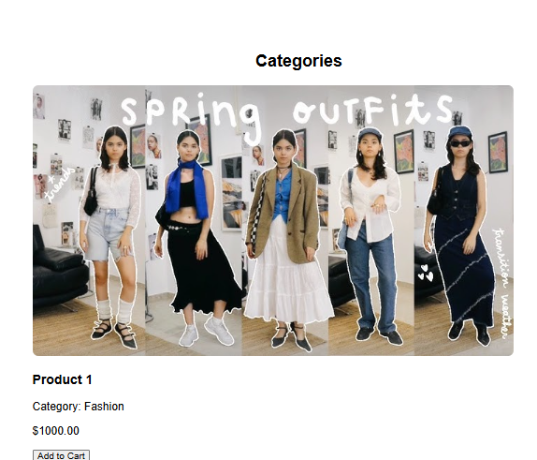
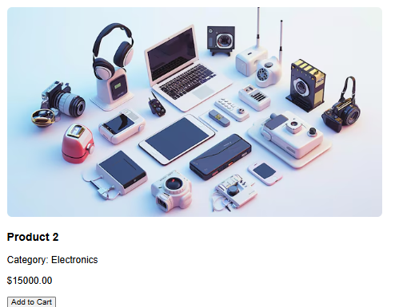
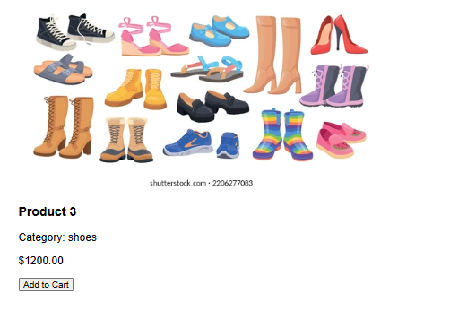

Slide 12
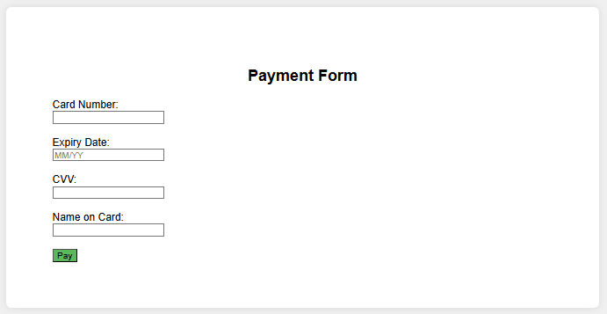
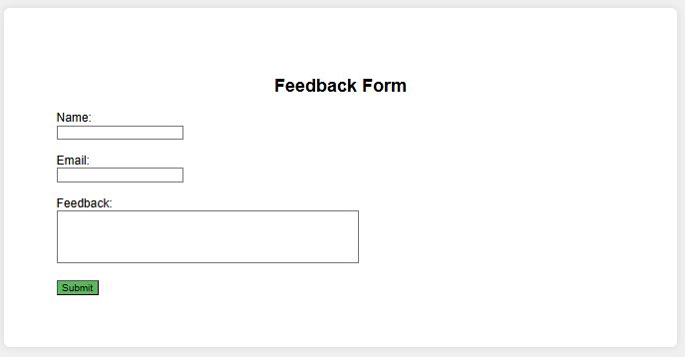

Slide 13

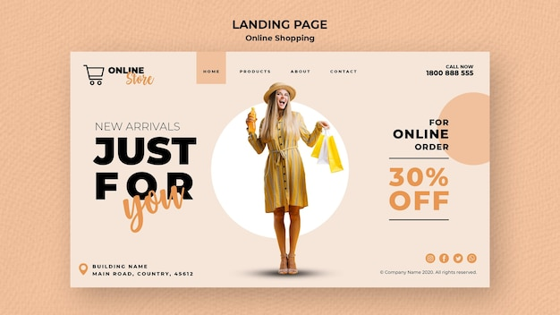
Conclusion and Future Enhancements
Online fashion wear shopping offers convenience, selection, and value. Future enhancements include personalized style recommendations, virtual try-on technology, and seamless social media integration.
In conclusion, online fashion wear shopping offers a convenient, diverse, and often cost-effective alternative to traditional brick-and-mortar stores.
Shoppers can explore a vast array of styles and brands from the comfort of their homes, often benefiting from competitive pricing and exclusive online deals.

Slide 14


